Slide 1
Soil System Functioning
by
Hermann Jungkunst Professor of Geoecology
at the
iES Landau

Slide 2
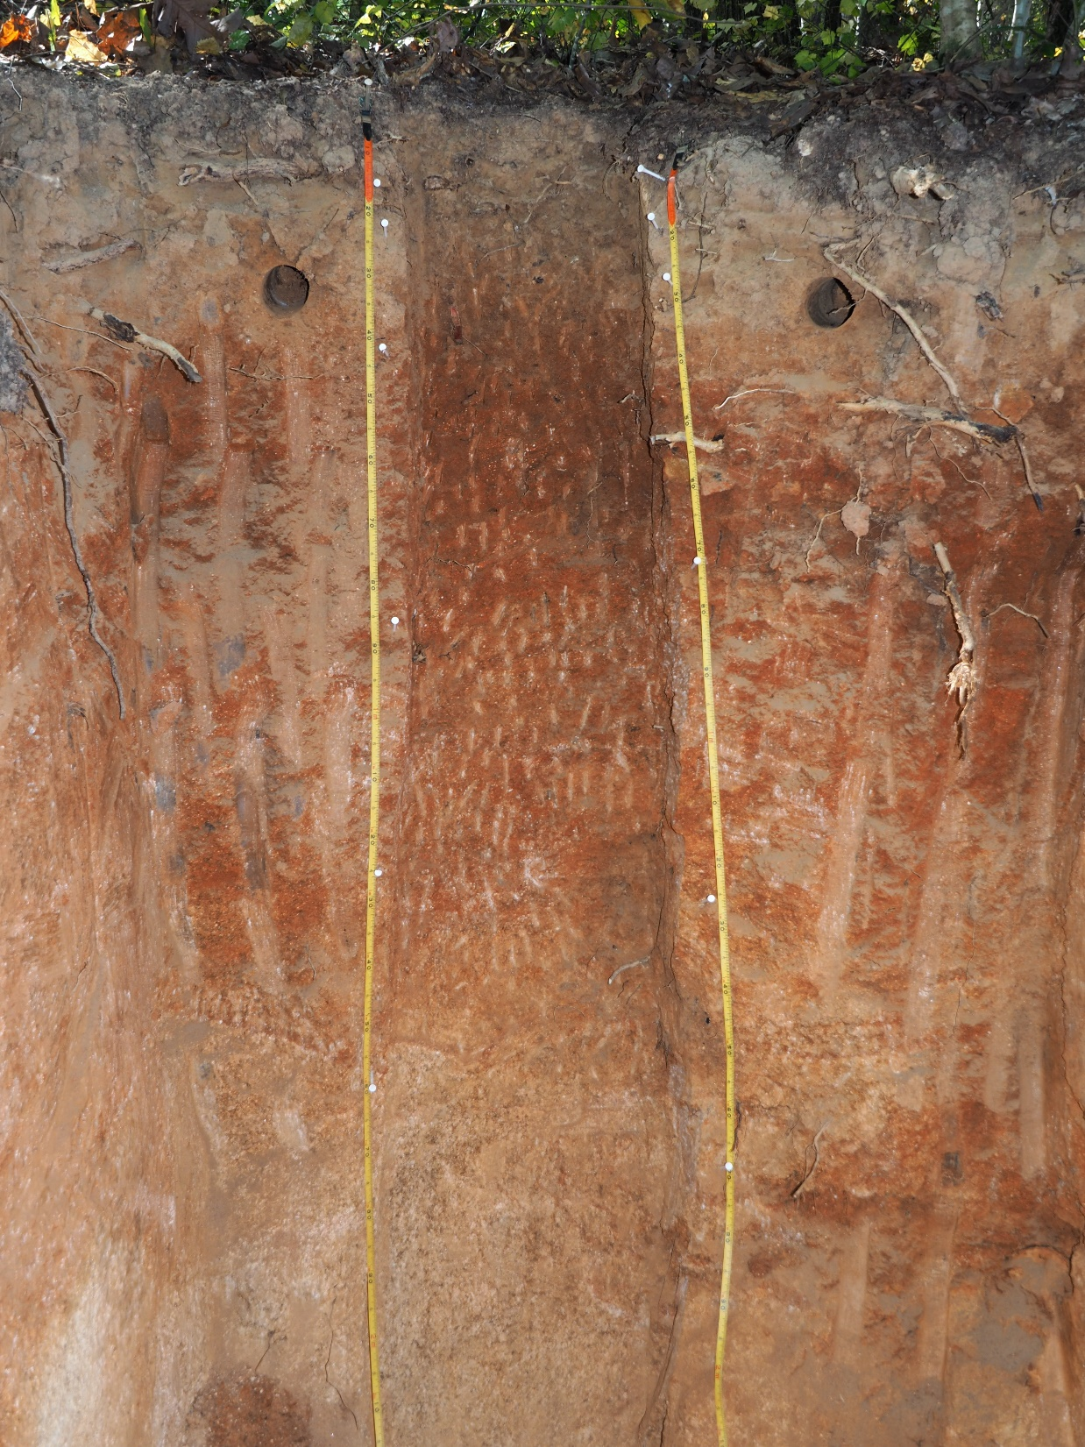
The concept of Ecosystem Services (ESS)
Lecture on soils by Hermann Jungkunst iES Landau
In general, ecosystem (goods and) services are the benefits that humans receive from ecosystems
2

Slide 3
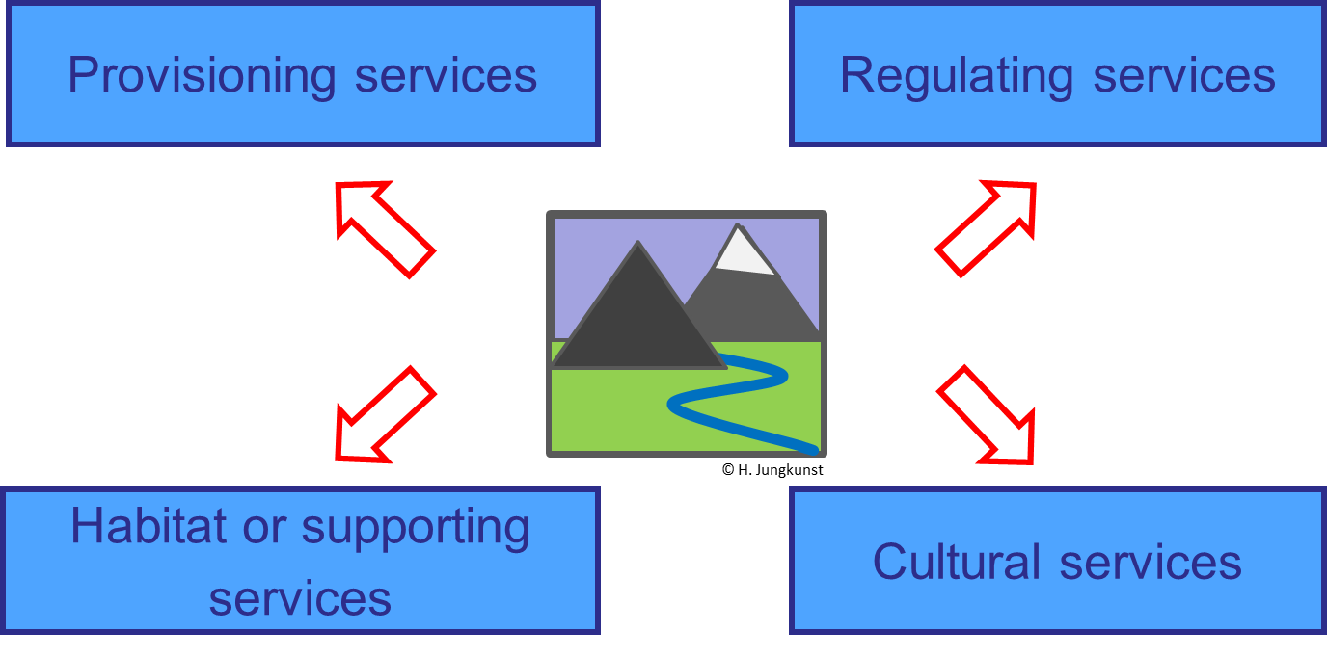
Lecture on soils by Hermann Jungkunst iES Landau
3

Slide 4
Lecture on soils by Hermann Jungkunst iES Landau
Provisioning services
Regulating services
Food
Local climate and air quality
C-Sequestration
Resources
Mitigation of extreme events
Freshwater
Water purification
Erosion protection
Medicine
Pollination
TEEB (2010), The Economics of Ecosystems and Biodiversity - Ecological and Economic Foundations. Edited by Pushpam Kumar. Earthscan: London and Washington
Biological pest control
4

Slide 5
Lecture on soils by Hermann Jungkunst iES Landau
Habitat or supporting services
Cultural services
Habitat
Aesthetics
Preservation of genetic diversity
Recreation
Spirituality
Tourism
5

Slide 6
Lecture on soils by Hermann Jungkunst iES Landau
Society
Individual well-being, security, material wants, health, social relations
Market-and Nonmarket values
Insurance value
Provisioning
Cultural
Food, Raw materials...
Aesthetics, Recreation...
Perception by society
Regulating
Climate, Extremes, Illnesses
Habitat/Supporting
ES-processes, Habitats
Nature / Ecosystems
adapted after TEEB (2010)
6

Slide 7
the processes in soils that control the functions and thus services are manifold and mostly take place at internal interfaces!
Lecture on soils by Hermann Jungkunst iES Landau
But soil are hidden beneath and often do not look appealing
7

Slide 8
Soils role in Nature?
Lecture on soils by Hermann Jungkunst iES Landau
rain
soil water
“ease external stress for ecosystems“
flatten the curve
e.g. water and nutrient availability
for plants
8

Slide 9
Soils role for Humanity?
Lecture on soils by Hermann Jungkunst iES Landau
“also to ease from external stress “
flatten the curve
e.g. pesticides, heavy metals
9

Slide 10
Soils role for Humanity?
Lecture on soils by Hermann Jungkunst iES Landau
“also to ease from external stress “
flatten the curve
Keep the Carbon
10

Slide 11
So it is agreed upon you do not want to loose soils and its functioning
Lecture on soils by Hermann Jungkunst iES Landau
South Carolina, USA – Forest regrowth on eroded soils
(badlands after intensive agriculture in 19th Century)
11

Slide 12
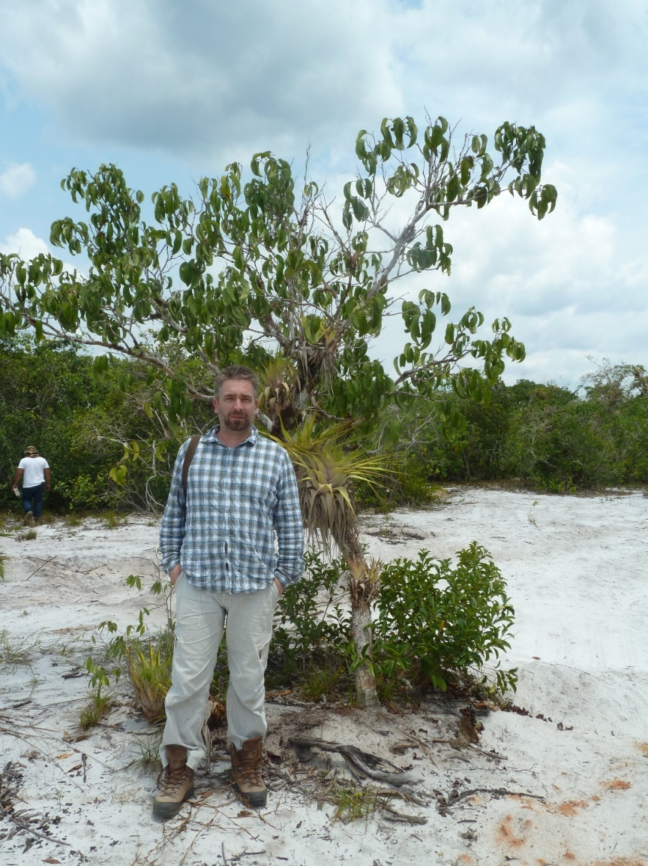
But soils do differ! Some have truly less capacity than others to carry ecosystems and humanity
Lecture on soils by Hermann Jungkunst iES Landau
Natural Rainforest, near Manaus –
On extremely poor soils
12

Slide 13
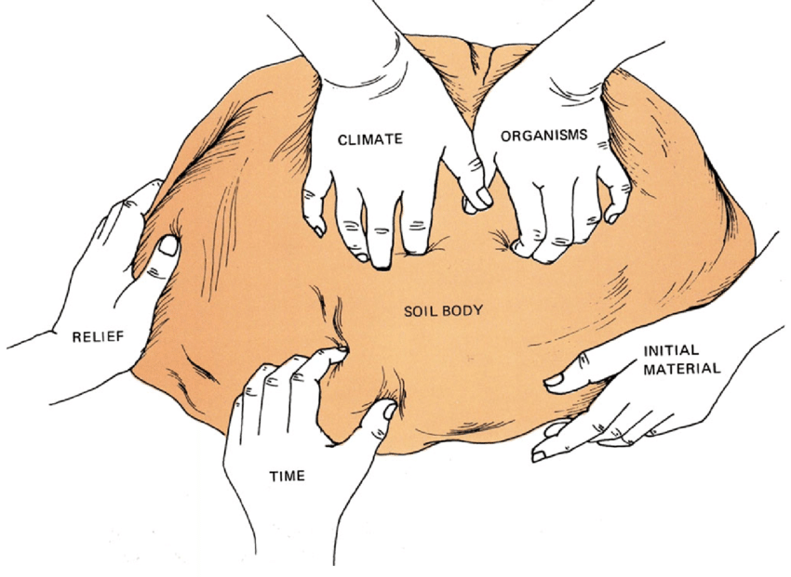
Why do soils differ?
Lecture on soils by Hermann Jungkunst iES Landau
Soil forming state factors differ across the globe and regions
13

Slide 14
Soil Genesis Jenny (1941)
soil forming
state factors
soil
processes
soil types
time
horizons
properties
climate
accumulation
depletion translocation transformation
parent
material
topography
lives plant, animals, humans
functions
State factors govern soil (forming) processes which results in regionally different soil types and therefore different functioning
Soil functions = f(t) {Time x Climate x Stones x Relief x Life
14

Slide 15
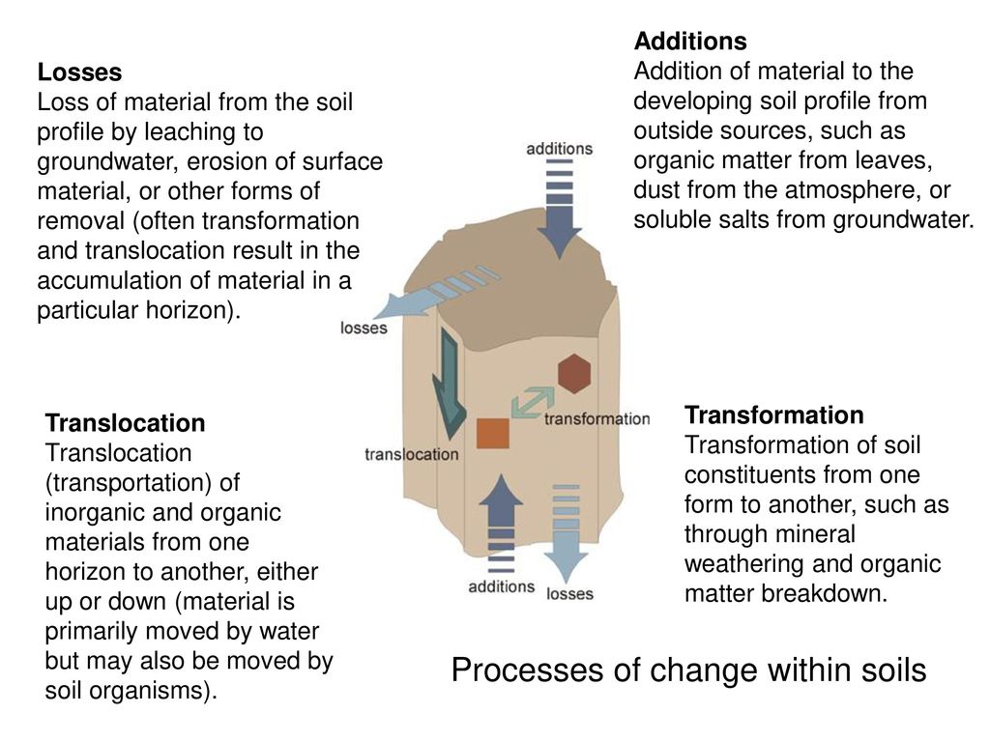
Lecture on soils by Hermann Jungkunst iES Landau
15

Slide 16
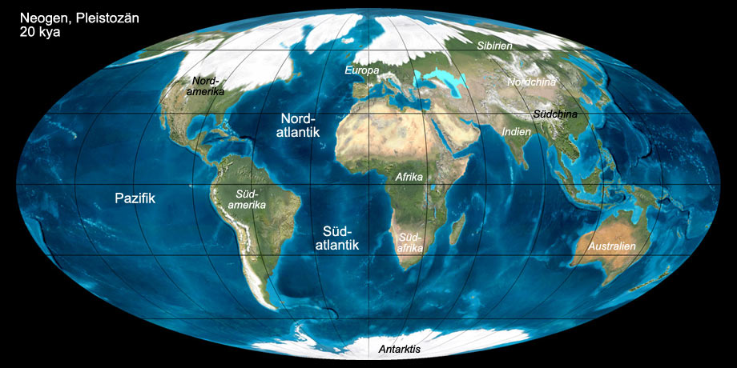
Time the most important state factor at the global scale
Lecture on soils by Hermann Jungkunst iES Landau
Ice Shield during ice ages renewing the soil of the north
16

Slide 17
Raw conceptual model of nutrient availability with time
Lecture on soils by Hermann Jungkunst iES Landau
high
young soils
mature soils
Tipping point crossed?
very young soils
Nutrient availability
old soils
low
young
time
old
Very
old soils
17

Slide 18
Raw conceptual model of nutrient availability with time
Lecture on soils by Hermann Jungkunst iES Landau
high
young soils
mature soils
Tipping point crossed?
No rapid change – gradual change
But hard to get back
Nutrient availability
very young soils
old soils
low
young
time
old
Very
old soils
18

Slide 19
It is a myth that ecosystem recycle resources perfectly They sustain via evolutionary adaption (Biodiv) e.g. to low nutrients But the ecosystems get more vulnerable to external stressors like us!!
Lecture on soils by Hermann Jungkunst iES Landau
19

Slide 20
So you may now think let us loose soils to get fresh and nutritional soil
Lecture on soils by Hermann Jungkunst iES Landau
South Carolina, USA – Forest regrowth on eroded soils
(badlands after intensive agriculture in 19th Century)
20

Slide 21
A sudden (man-made) erosion of soil would mean crossing a tipping point evolutionary adaption (Biodiv) could not follow - chaos That is one of the reasons why most of the tropics are most likely more vulnerable than e.g. Europe , but also more important in many aspects for the earth system!!! Unfair I know
Lecture on soils by Hermann Jungkunst iES Landau
21

Slide 22
Lack of erosion applies to region lacking topographical differences (relief) or in other words it only applies for mountainous regions Most regions of the world are flat so without glaciers soils continuously get older
Lecture on soils by Hermann Jungkunst iES Landau
22

Slide 23
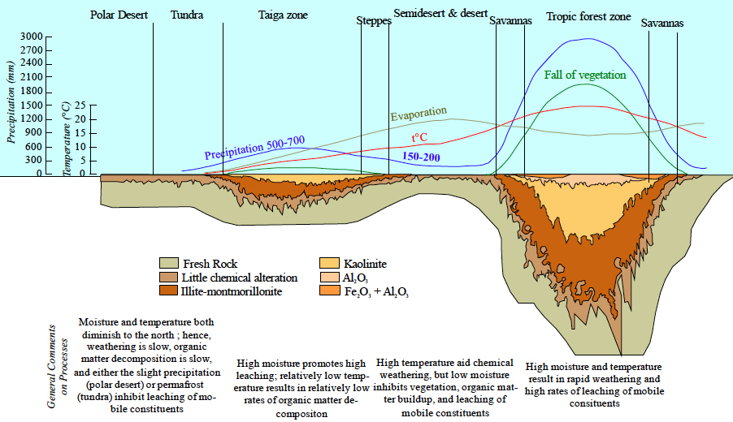
Why do soils differ? Soil forming factors
Lecture on soils by Hermann Jungkunst iES Landau
Without water or if it is cold soil genesis is slow
23

Slide 24
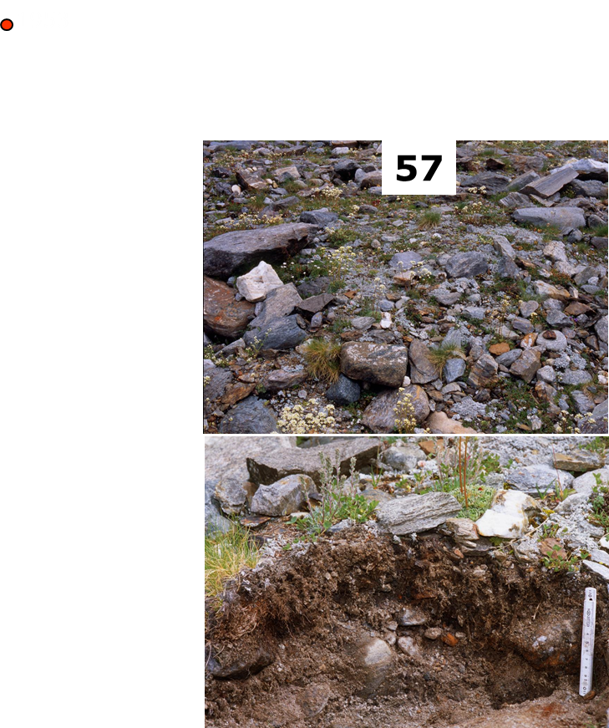
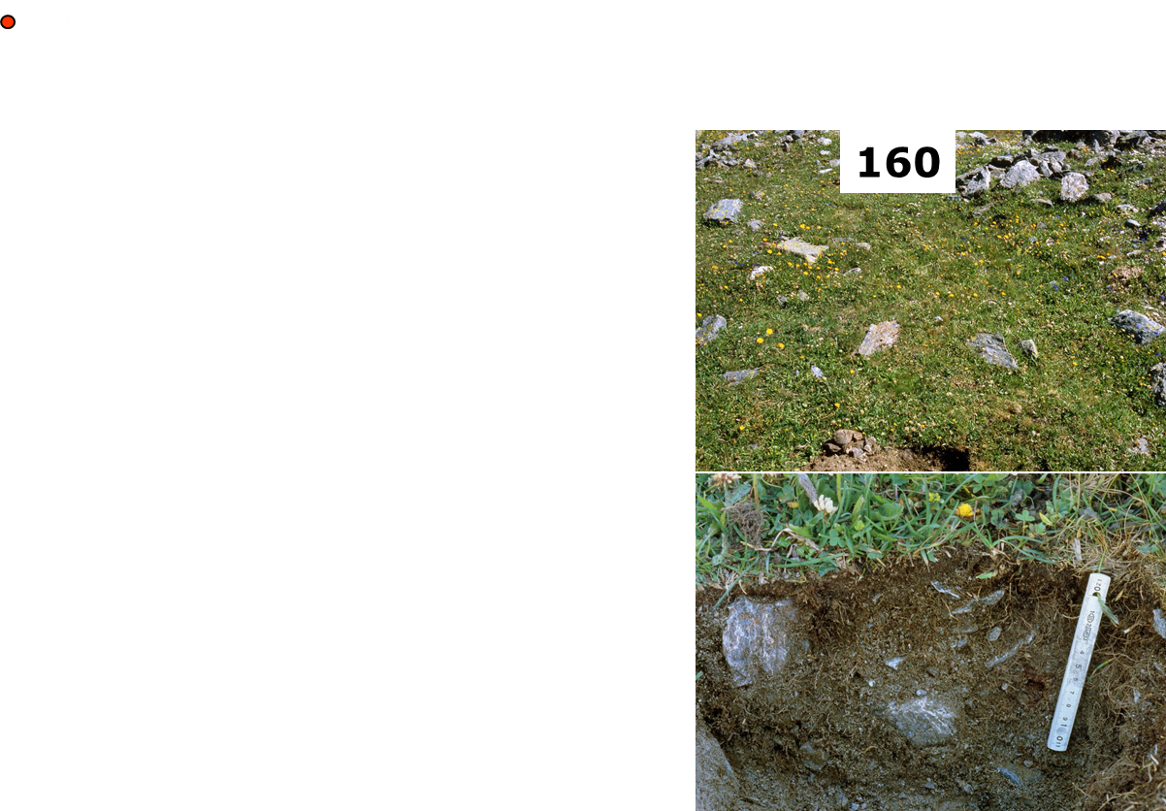
Lecture on soils by Hermann Jungkunst iES Landau
Feedback soil to plants and climate
Carbon accumulation with the retreat of a glacier
Change in Albedo
Darker – warmer
But CO₂ sequestered
24

Slide 25
So it is fairly novel to consider soil biodiversity as the rock in the surf to maintain soil functioning with soil ageing
Lecture on soils by Hermann Jungkunst iES Landau
25

Slide 26
What did we miss? Where in soils is soil biodiversity the rock in the surf to maintain soil functioning with soil ageing?
Lecture on soils by Hermann Jungkunst iES Landau
26

Slide 27
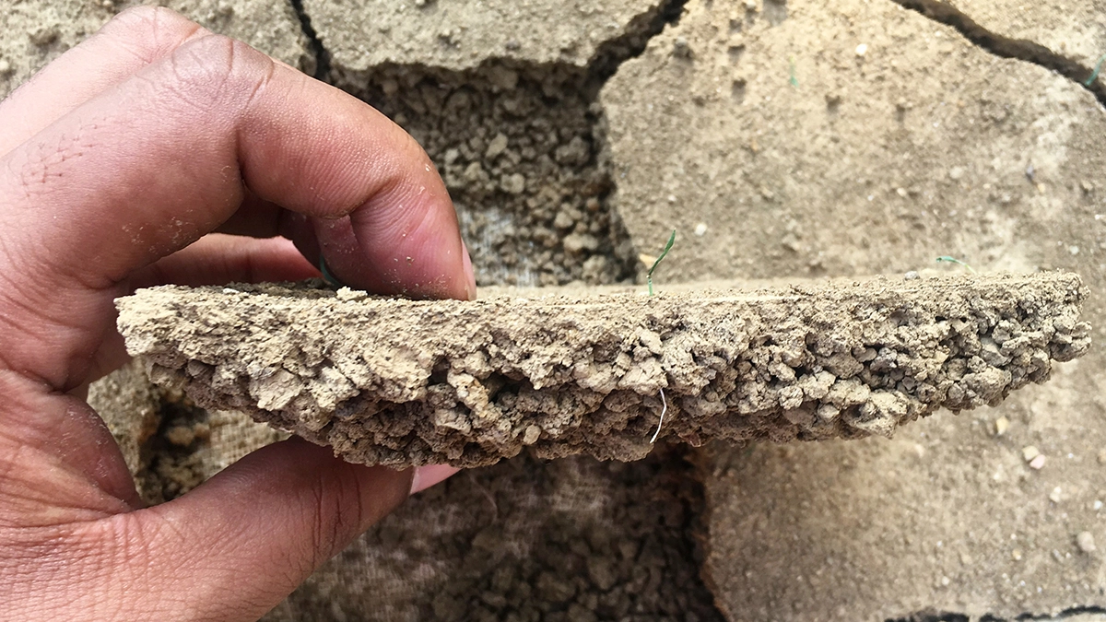
crushed or pulverized soil is related to the soil formed by nature like a pile of debris to a demolished building (KUBIENA 1936)

Slide 28
Problem – soil structure (aggregation) changes quickly

Slide 29
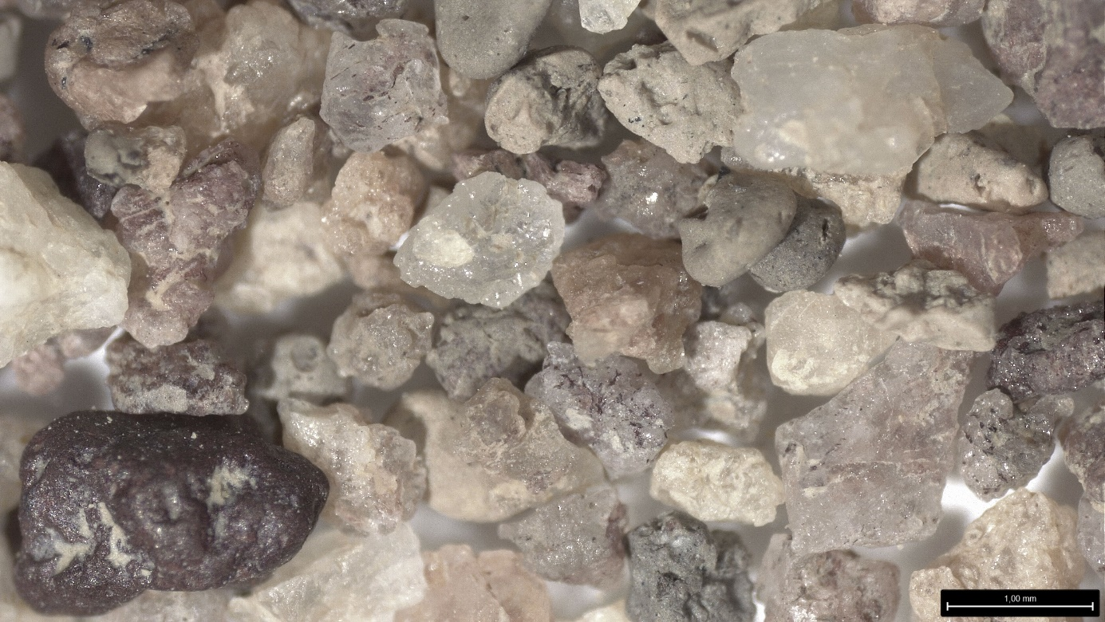
One Exception Pseudosands in the tropics

Slide 30
Thank you and I looking very much forward receiving your feedback and questions – and I hope you will be eager to go more into depths of soil functioning as related to soil biodiversity
Lecture on soils by Hermann Jungkunst iES Landau
30

