Slide 2
Soil structure dynamics as influenced by soil carbon and soil fauna
Katharina Meurer
Department of Soil & Environment
Swedish University of Agricultural Sciences, Uppsala, Sweden

Slide 3
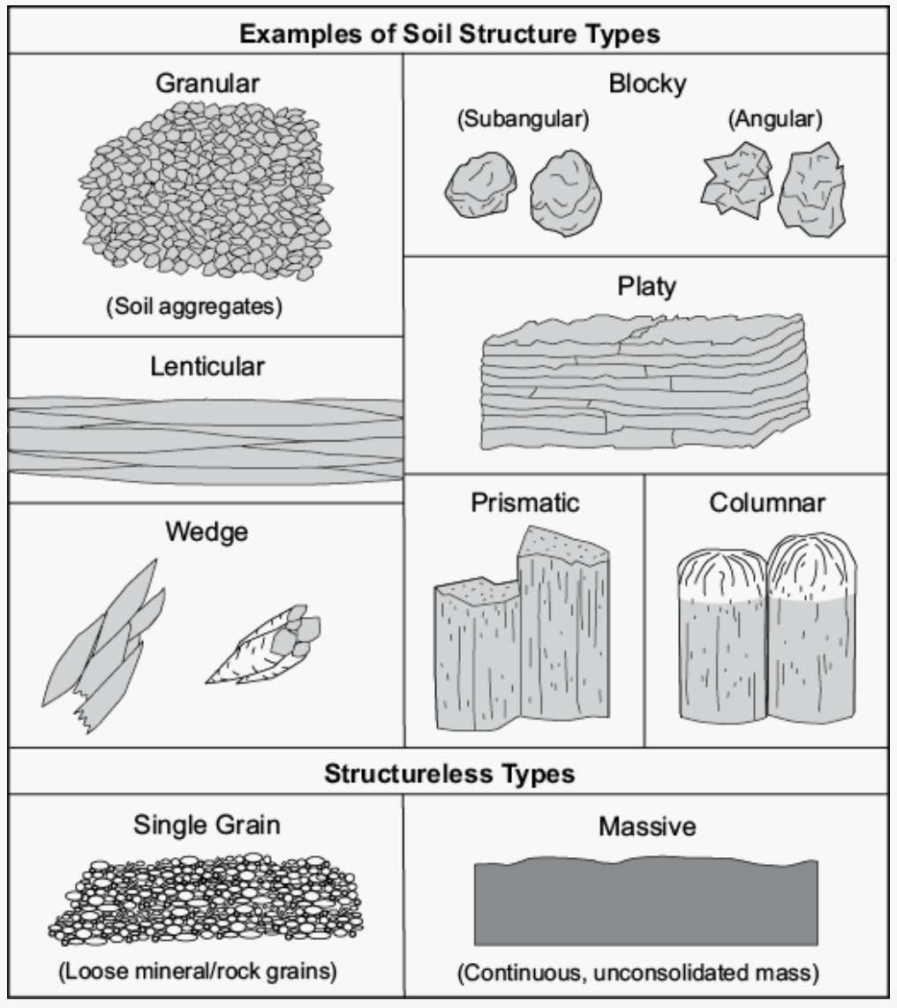
http://www.thedailygarden.us/uploads/4/5/4/9/45493619/screen-shot-2020-01-15-at-10-14-05- am_orig.png

Slide 4
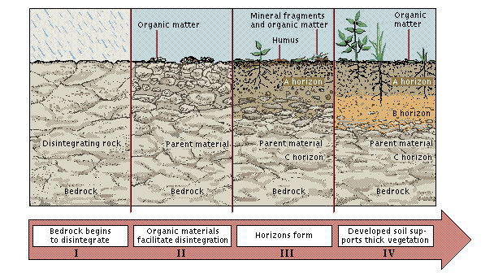
Soil formation
https://thegrowingseason.wordpress.com/2013/05/10/soils-management-the-old-jar-test/

Slide 5
Soil structure development
Physical-chemical processes
Polyvalent cations (Ca²⁺, Mg²⁺, Al³⁻) bind together clay particles
Particles are moved by freezing/thawing, wetting/ drying, and root growth
Biological processes
Humus acts like cement
Organic glues created by fungi and bacteria decomposing organic matter
Polymers and sugars excreted from roots
Fungal hyphae and fine roots stabilize aggregates

Slide 6
Soil structure development
Physical-chemical processes
Polyvalent cations (Ca²⁺, Mg²⁺, Al³⁻) bind together clay particles
Particles are moved by freezing/thawing, wetting/ drying, and root growth
Biological processes
Humus acts like cement
Organic glues created by fungi and bacteria decomposing organic matter
Polymers and sugars excreted from roots
Fungal hyphae and fine roots stabilize aggregates
! !
Organic matter and
plant roots

Slide 7
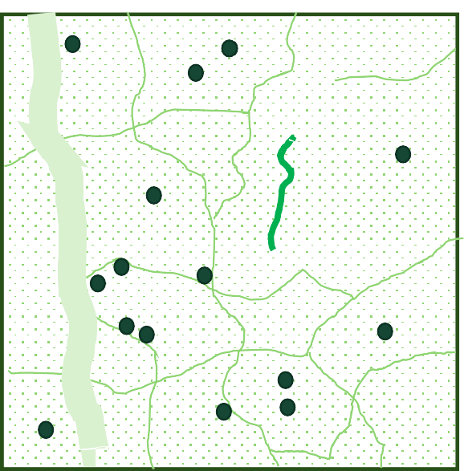
Describing ”soil structure”
B
D
A
E
C
macropores (> 300 µm)
mesopores (30 – 300 µm)
micropores (< 30 µm)
POM e.g. decaying roots
microbially-processed organic matter

Slide 8
How to destroy soil structure?
Compaction
Cultivation
Removal of vegetation
Soil pollution
Excessive levels of sodium (Na)
Excessive moving and handling of soil

Slide 9
How to destroy soil structure?
Compaction
High proportion of Na to Ca and Mg causes clay particles
to repel each other when wet.
Soils can become almost impermeable to water because
the dispersed clay and small organic particles clog up
remaining soil pores (Donahue et al. (1983) Soils: and introduction to soils and plant growth. Fifth Edition. Prentice-Hall, Inc.: Englewood Cliffs, N.J).
Cultivation
Removal of vegetation
Soil pollution
Excessive levels of sodium (Na)
Excessive moving and handling of soil

Slide 10
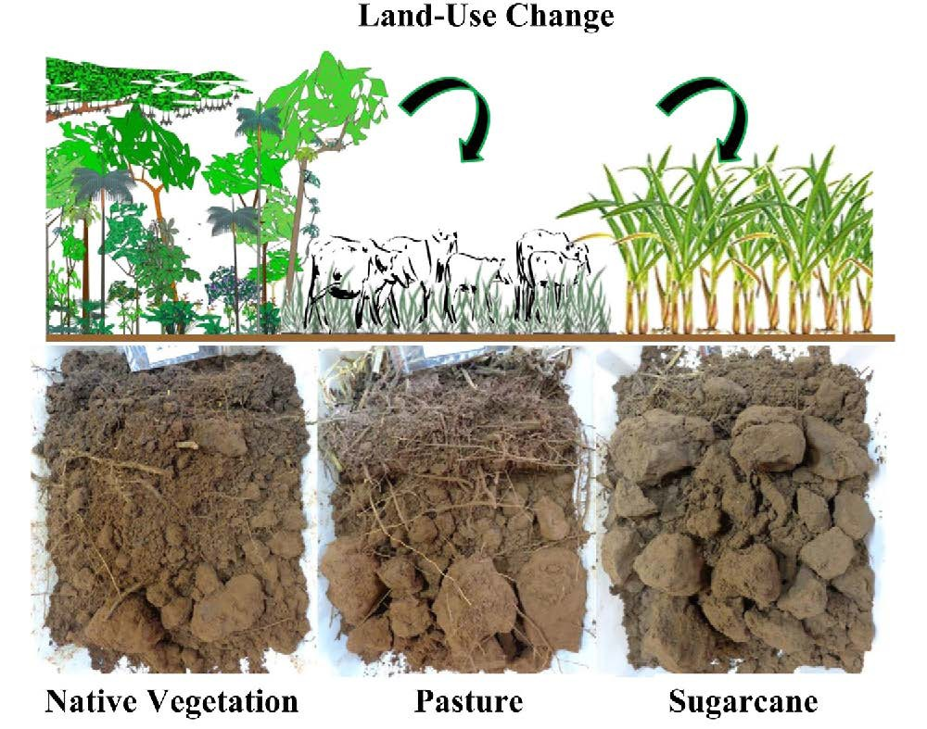
Cherubin et al. (2017) https://doi.org/10.1016/J.STILL.2016.05.004

Slide 11
Greater structural quality, supporting
a suitable environment for root system growth and exploitation of deeper soil layers
Poorer structural soil quality – mainly in 10 – 25 cm depth
→ Management practice changes are needed to alleviate soil compaction
Cherubin et al. (2017) https://doi.org/10.1016/J.STILL.2016.05.004

Slide 12
Thicker layer of better soil quality due
to greater inputs of soil organic matter and biological activity associated with absence of soil tillage and management
Thinner layer of ”good” soil structural quality (rhizosphere
zone) overlying a compacted and thicker soil layer
→ Cattle trampling
→ Tillage operations
→ Intensive machinery traffic under ”bad” conditions
Cherubin et al. (2017) https://doi.org/10.1016/J.STILL.2016.05.004

Slide 13
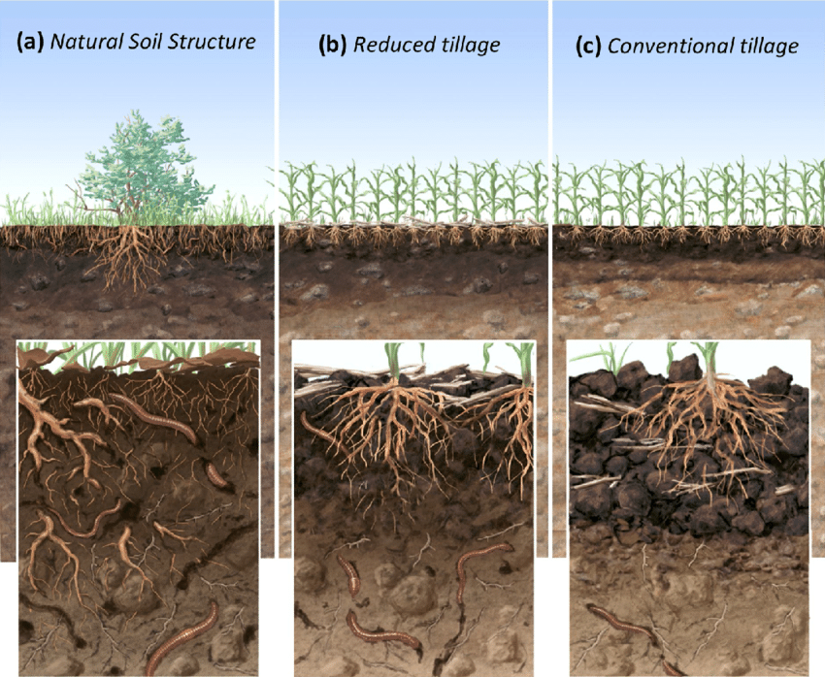
Or et al. (2021) 10.1016/j.still.2020.104912

Slide 14
lack of vegetation diversity and soil
organic carbon accumulation (still higher biological acitivity than con- ventional tillage
mechanical fragmentation of the top
layer, consolidation of the loose structure (biol activity in undisturbed subsurface)
soil-fauna-vegetation-climate feed-
backs (accumulation of biopores and invisible soil aggregation)
Or et al. (2021) 10.1016/j.still.2020.104912

Slide 15
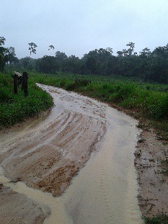
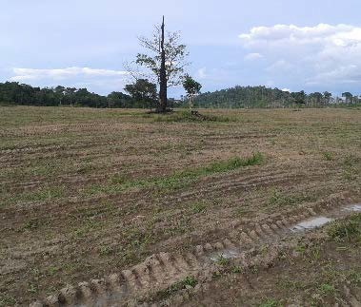
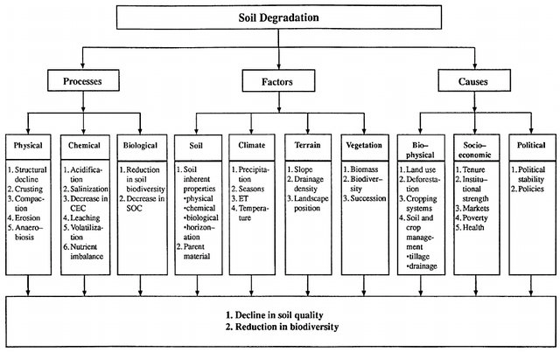
Soil degradation
Lal (1997) 10.1098/rstb.1997.0078

Slide 16
Soil degradation
”the decline in soil quality caused through its misuse by humans”¹
every year, 12 million hectares are lost worldwide because of soil degradation²
considered a global threat
determined by soil structure, i.e. the spatial arrangement and stability of soil solids and pore space³
controls all key soil processes, e.g. air and water movement, microbial activity, carbon and nitrogen cycling, root growth⁴
¹ Lal & Stewart (1990) Soil degradation: A global threat. In: R Lal & BA Stewart, Advances in Soil Sciences, Volume 11, Soil Degradation, Springer-Verlag
² FAO/ITPS. 2015. FAO/ITPS, Rome, Italy
³ Dexter, A (1988) Advances in characterization of soil structure. Soil & Till. Res., 11, 199-238.
⁴ Rabot et al. (2018) Soil structure as an indicator of soil functions: A review. Geoderma, 314, 122-137.

Slide 17
The vicious circles of soil degradation
POOR CROP GROWTH
REDUCED WATER STORAGE and INCREASED RUNOFF
Soil degradation
REDUCED C INPUT
DEGRADED STRUCTURE
REDUCED SOM
Dynamic changes in soil hydraulic properties that affect soil water balance, crop growth and soil carbon storage at decadal to centennial time-scales

Slide 18
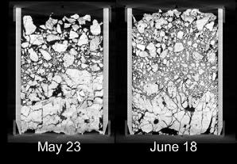
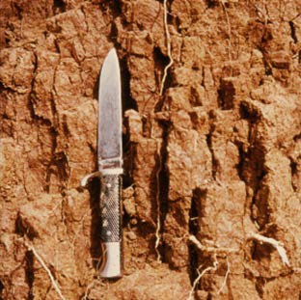
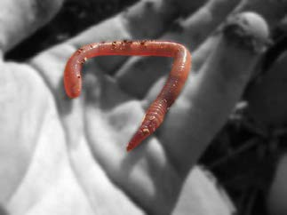
Many physical and biological processes drive the formation and degradation of soil structure
Surfacesealing
Climate/weather
Boundary conditions
Assimilation
Transport processes
Off-site impacts Runoff, flooding Erosion, Leaching
Swell/shrink, Consolidation
Soil management Tillage, traffic Poaching/trampling
SOIL STRUCTURE
Soil states Watercontents Potentials Concentrations Temperature
Crop management Fertilization Irrigation
Loosening, compaction
Drilling, compression
Plant biomass
Leaves Stems Roots
Crop management
Harvest Grazing
Root penetration
Burrowing, compression
Macro- and mesofauna Biomass, activity
Aggregation
Soil organic matter
Food supply
Decomposition
Organic amendments

Slide 19
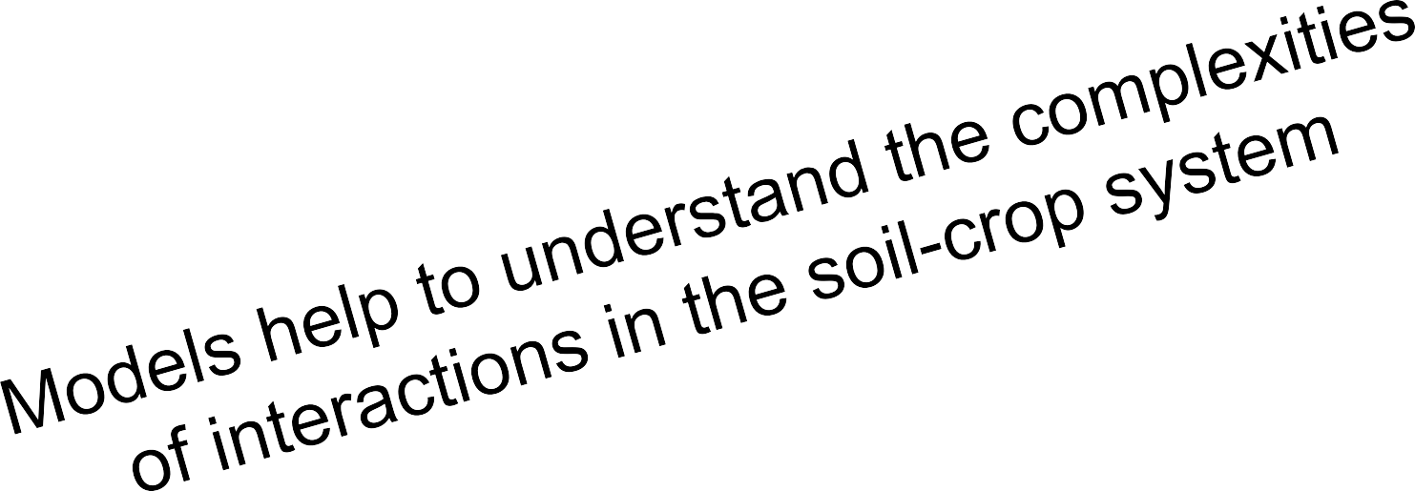
Many physical and biological processes drive the formation and degradation of soil structure
Surfacesealing
Climate/weather
Boundary conditions
Assimilation
Transport processes
Off-site impacts Runoff, flooding Erosion, Leaching
Swell/shrink, Consolidation
Soil management Tillage, traffic Poaching/trampling
SOIL STRUCTURE
Soil states Watercontents Potentials Concentrations Temperature
Crop management Fertilization Irrigation
Loosening, compaction
Drilling, compression
Plant biomass
Leaves Stems Roots
Crop management
Harvest Grazing
Root penetration
Burrowing, compression
Macro- and mesofauna Biomass, activity
Aggregation
Soil organic matter
Food supply
Decomposition
Organic amendments

Slide 20
The vicious circles of soil degradation
POOR CROP GROWTH
REDUCED WATER STORAGE and INCREASED RUNOFF
Soil degradation
REDUCED C INPUT
DEGRADED STRUCTURE
The missing link in soil-crop models
REDUCED SOM
Dynamic changes in soil hydraulic properties that affect soil water balance, crop growth and soil carbon storage at decadal to centennial time-scales

Slide 21
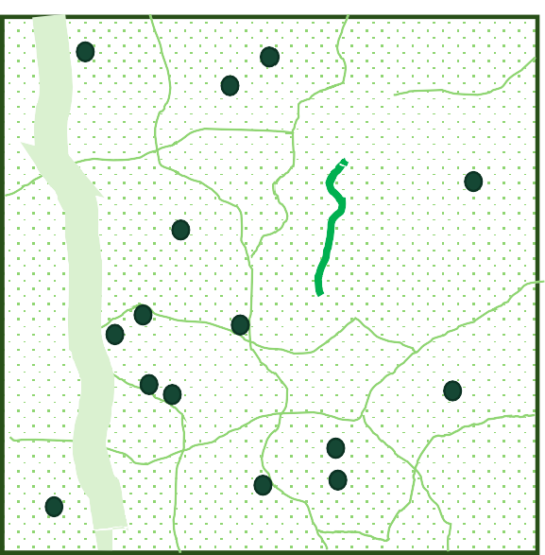
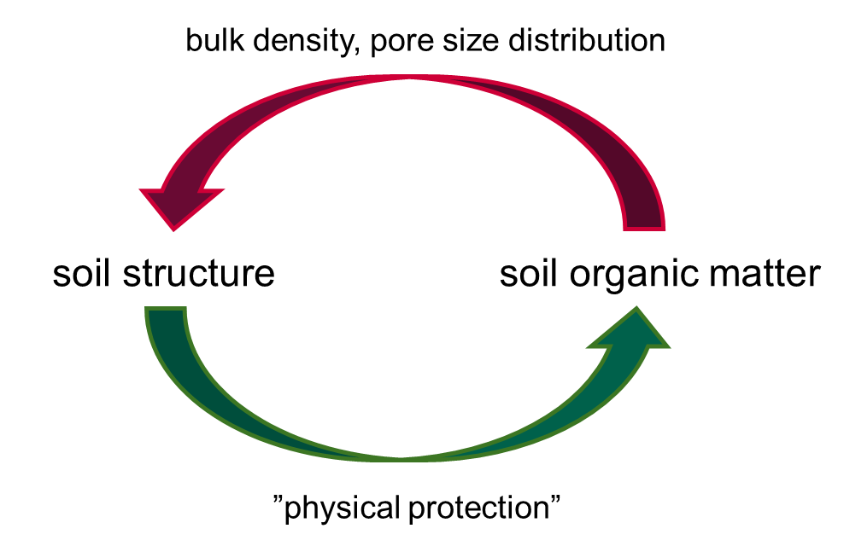
Coupled modelling of soil organic matter dynamics and soil structure
B
D
Two-way interaction between soil structure and SOM
A
E
C
A) macropores (> 300 µm)
mesopores (30 – 300 µm)
micropores (< 30 µm)
POM e.g. decaying roots
microbially-processed organic matter

Slide 22
The influence of soil structure on SOM turnover and storage (extended ICBM model¹)
OM input (litter and roots, organic amendments)
$$I_{m}+\left(\frac{φ_{mes}}{φ_{mes}+φ_{mic}}\right)I_{r}$$
$${ε k}_{Y}M_{y(mes)}$$
M_{y(mes)}
M_{o(mes)}
Mesoporous region
$${\left(1−ε\right) k}_{y}M_{y(mes)}$$
$${\left(1−ε\right) k}_{O}M_{y(mes)}$$
Mixing (tillage and bioturbation)
$$M_{till}\left(\frac{M_{\left.Y(mic\right)}−M_{\left.Y(mes\right)}}{2}\right)$$
Mineralization
$$M_{till}\left(\frac{M_{\left.O(mic\right)}−M_{\left.O(mes\right)}}{2}\right)$$
M_{y(mic)}
$${\left(1−ε\right) k_{Y}F}_{prot}M_{\left.Y(mic\right)}$$
$${\left(1−ε\right) k_{O}F}_{prot}M_{\left.O(mic\right)}$$
M_{o(mic)}
Microporous region
$$\left(\frac{φ_{mic}}{φ_{mes}+φ_{mic}}\right)I_{r}$$
$${ε k_{Y}F}_{prot}M_{\left.Y(mic\right)}$$
OM input (roots)
¹Andrén & Kätterer (1997) Ecological Applications, 7, 1226-1236
Meurer et al. (2020) Biogeosciences, 17(20), 5025-5042

Slide 23
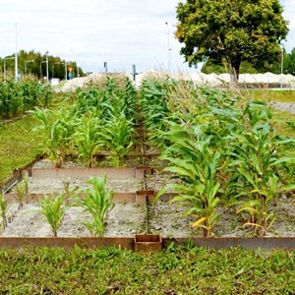
Application to the Ultuna long-term ”frame” trial
Treatment | Mineral fertilizer [kg N ha⁻¹ yr⁻¹] | Organic material [t C ha⁻¹] *
bare fallow (A) | 0 | 0
no-N (B) | 0 | 0
Ca(NO₃)₂ (C) | 80 | 0
(NH₄)₂SO₄ (D) | 80 | 0
kkv (E) | 80 | 0
straw (F) | 0 | 4
straw (G) | 80 | 4
green manure (H) | 0 | 4
peat (I) | 0 | 4
animal manure (J) | 0 | 4
animal manure (K) | 0 | 4
saw dust (L) | 0 | 4
peat (M) | 80 | 4
saw dust (N) | 80 | 4
sewage sludge (O) | 0 | 4
* applied every other year
RAM-56 Organic matter trial

Slide 24
Application to the Ultuna long-term ”frame” trial
Parameter | Value | Variation
1st order rate coefficient, k_{o} (year⁻¹) OM retention coefficient, ε OM input spin-up (g cm⁻² year⁻¹) Fraction of textural micropores, f_{text(mic)} | 0.036 0.37 0.0064 0.85 | 0.031 – 0.039 0.35 – 0.39 0.0061 – 0.0066 0.84 – 0.87
Meurer et al. (2020) Biogeosciences, 17(20), 5025-5042
Data from:
Kirchmann et al. (1994) Dept. Soil Sciences, Reports and Dissertations 17, Swedish University of Agricultural Sciences, Uppsala, Sweden. Gerzabek et al. (1997) European Journal of Soil Science, 48, 273-282.
Kirchmann & Gerzabek (1999) Journal of Plant Nutrition and Soil Science, 162, 493-498. Kätterer et al. (2011) Agriculture, Ecosystems and Environment, 141, 184-192.

Slide 25
Application to the Ultuna long-term ”frame” trial
Predictions for the green manure treatment
Meurer et al. (2020) Biogeosciences, 17(20), 5025-5042

Slide 26
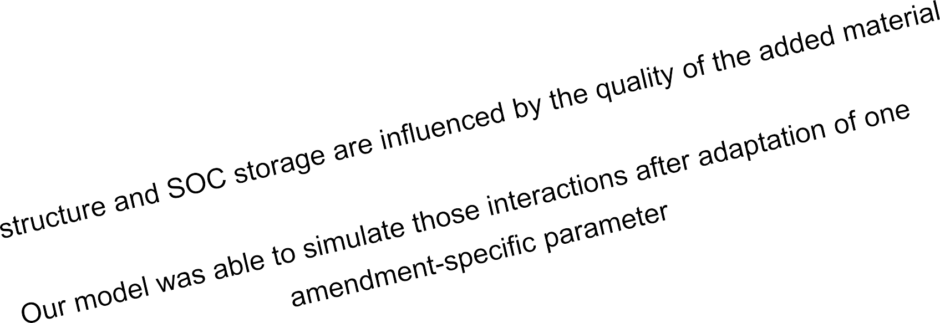
Application to the Ultuna long-term ”frame” trial
Predictions for the green manure treatment

Slide 27
Biological agents and processes
… are particularly important for the maintenance of soil structure and recovery of degraded soils (e.g. Angers & Caron 1998; Colombi & Keller 2019)
What kind of biological agents influence soil structure?
Angers & Caron (1998) Biogeochemistry, 42, 55–72
Colombi & Keller (2019) Soil and Tillage Research, 191, 156–161.

Slide 28
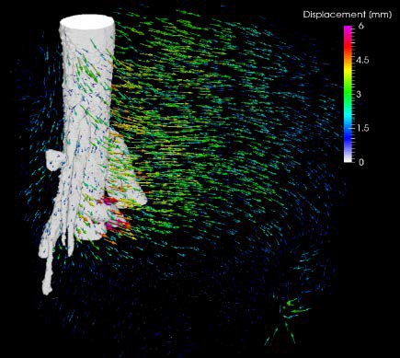
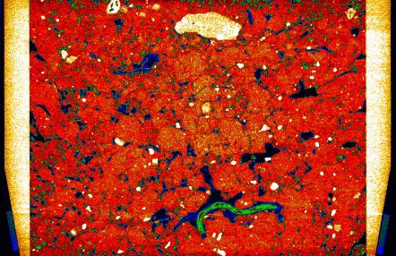
Effects of root growth and soil fauna on soil structure
Root growth | Soil fauna (earthworms)
Particle displacement
Compressing pre-existing pores
Creation of biopores
Supply of organic carbon | Processing of organic material as food source
Increase soil stability | Changing pore size distribution and water retention properties through casts
Water uptake and soil shrinkage | Displacement of ingested soil within the soil profile and the surface
Koestel & Schlüter (2019)

Slide 29
Which pores are created or which pores are being destructed by root growth and soil fauna?
Soil fauna (earthworms)
macropores
mesopores
micropores
creation
Root growth
destruction

Slide 30
Modelling approach and assumptions
Soil fauna (earthworms)
macropores
mesopores
micropores
creation
Root growth
destruction

Slide 31
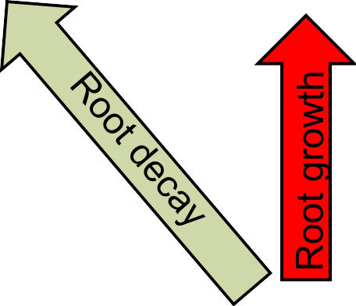
Modelling approach and assumptions
Soil fauna (earthworms)
macropores
mesopores
micropores
Root decay
creation
Root growth
destruction

Slide 32
Modelling approach and assumptions
Soil fauna (earthworms)
Ingestion
macropores
mesopores
micropores
Root decay
creation
Root growth
destruction

Slide 33
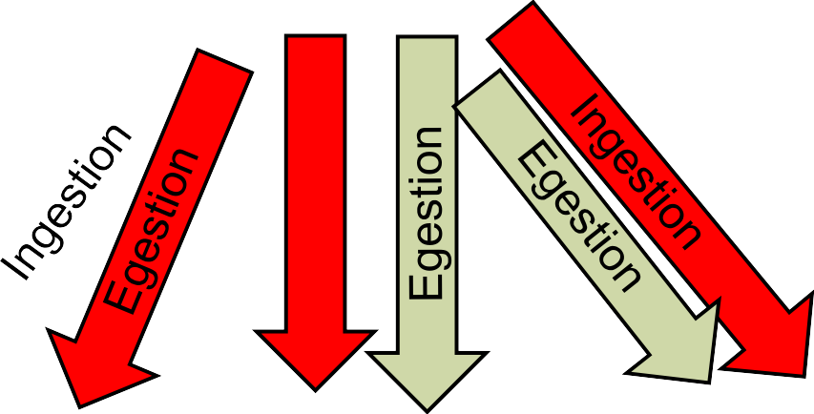
Modelling approach and assumptions
Soil fauna (earthworms)
Ingestion
macropores
mesopores
micropores
Root decay
creation
Root growth
destruction

Slide 34
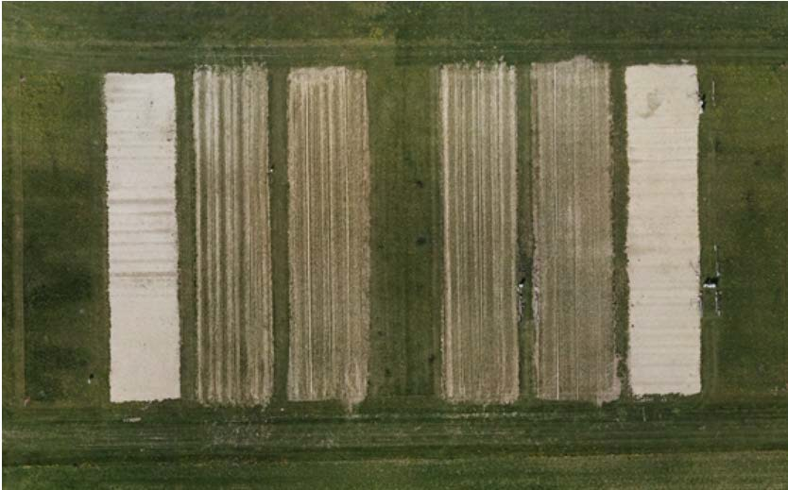
Model testing: Soil Structure Observatory in Zurich
Keller et al. (2017) Vadose Zone Journal, 16(4)
Development of soil structure after heavy compaction
https://www.agroscope.admin.ch/agroscope/en/home/topics/environment- resources/monitoring-analytics/long-term-trials/sso.html

Slide 35
Model testing: Soil Structure Observatory in Zurich
Keller et al. (2017) Vadose Zone Journal, 16(4)
Development of soil structure after heavy compaction
https://www.agroscope.admin.ch/agroscope/en/home/topics/environment- resources/monitoring-analytics/long-term-trials/sso.html
Bare soil
Permanent grass
No tillage
Conventional tillage

Slide 36
Model testing: Soil Structure Observatory in Zurich
Keller et al. (2017) Vadose Zone Journal, 16(4)
Development of soil structure after heavy compaction
https://www.agroscope.admin.ch/agroscope/en/home/topics/environment- resources/monitoring-analytics/long-term-trials/sso.html
Bare soil
Permanent grass
No tillage
Conventional tillage

Slide 37
Model testing: Soil Structure Observatory in Zurich
Keller et al. (2017) Vadose Zone Journal, 16(4)
Development of soil structure after heavy compaction
https://www.agroscope.admin.ch/agroscope/en/home/topics/environment- resources/monitoring-analytics/long-term-trials/sso.html
Bare soil
Permanent grass
No tillage
Conventional tillage
Only faunal bioturbation considered

Slide 38
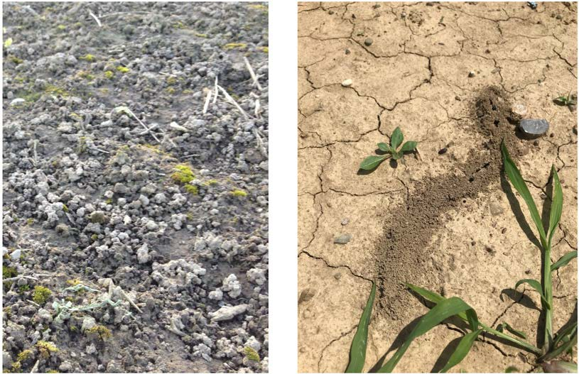
Model testing: Soil Structure Observatory in Zurich
Keller et al. (2017) Vadose Zone Journal, 16(4)
Development of soil structure after heavy compaction
Deposition of soil at the surface
earthworms
ants
Keller et al. (2017)

Slide 39
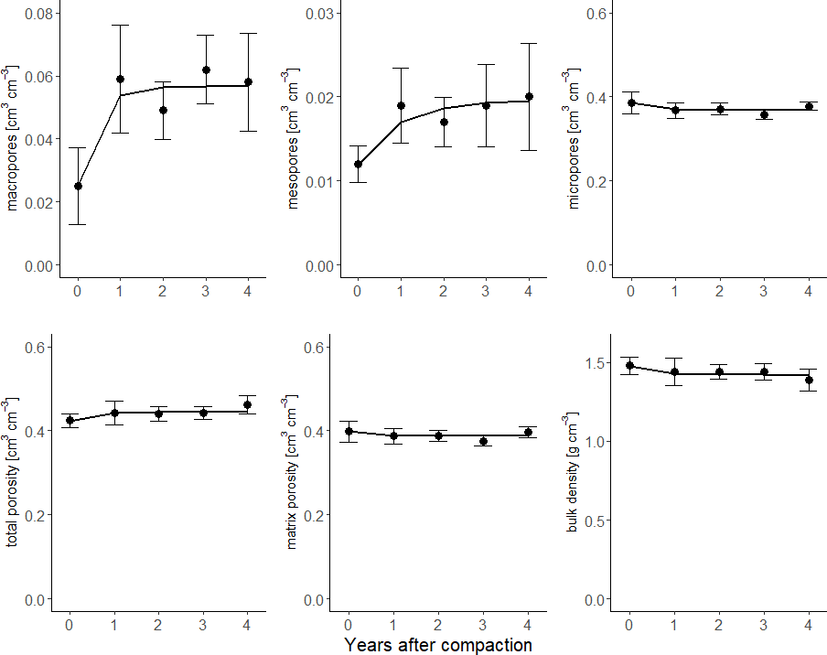
Model testing: Soil Structure Observatory in Zurich
Keller et al. (2017) Vadose Zone Journal, 16(4)
Meurer et al. (2020) Global Change Biology, 26(10), 5382-5403

Slide 40
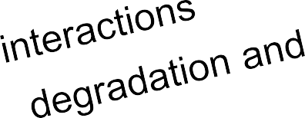
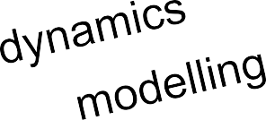
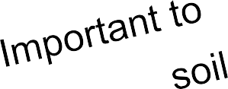
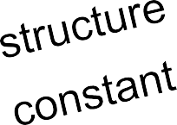
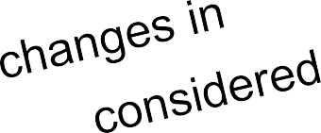
Model testing: Soil Structure Observatory in Zurich
Keller et al. (2017) Vadose Zone Journal, 16(4)
Meurer et al. (2020) Global Change Biology, 26(10), 5382-5403

Slide 41
Thank you for your attention ☺
Questions?
Dr. Katharina Meurer
Department of Soil & Environment Swedish University of Agricultural Sciences Uppsala, Sweden
katharina.meurer@slu.se Office: 018672463
Mobile: 0738061576

