Slide 1

Task 3.3: Assessment/forcast of the evaluation of soil threats and soil-based ecosystem services according to climatic scenarios and/or changes in land-uses /management
Barbara Kitzler & Christian Walter, 7 March 2023

Slide 2
Aims of Task 3.3
1) Evaluate SOIL THREATS (ST) and SOIL ECOSYSTEM SERVICES (SES) according to
-> different climate change
-> land use/cover and
-> management scenarios
1a) Literature review of existing scenario studies
1b) model selected SES/ST and bundles for defined CC/LU/LM scenarios on a plot/regional/national scale

Slide 3
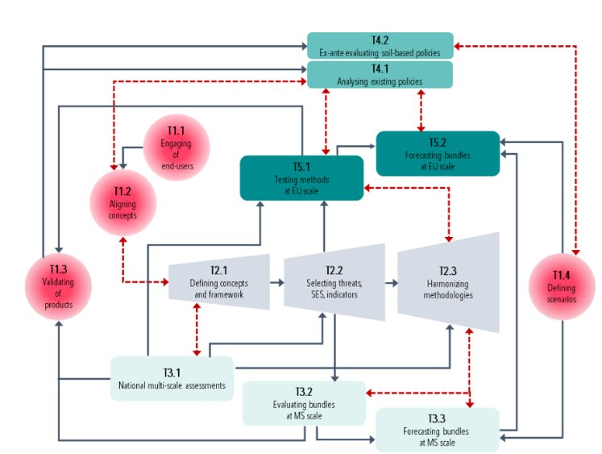
Dependencies and providance of T3.3
Depending on T 3.2 for evaluating bundles at MS scale
Depending on the T 2.3 cookbook
Depending on T 1.4 for definition of scenarios to be used
Provide and depend on T 5.2

Slide 4
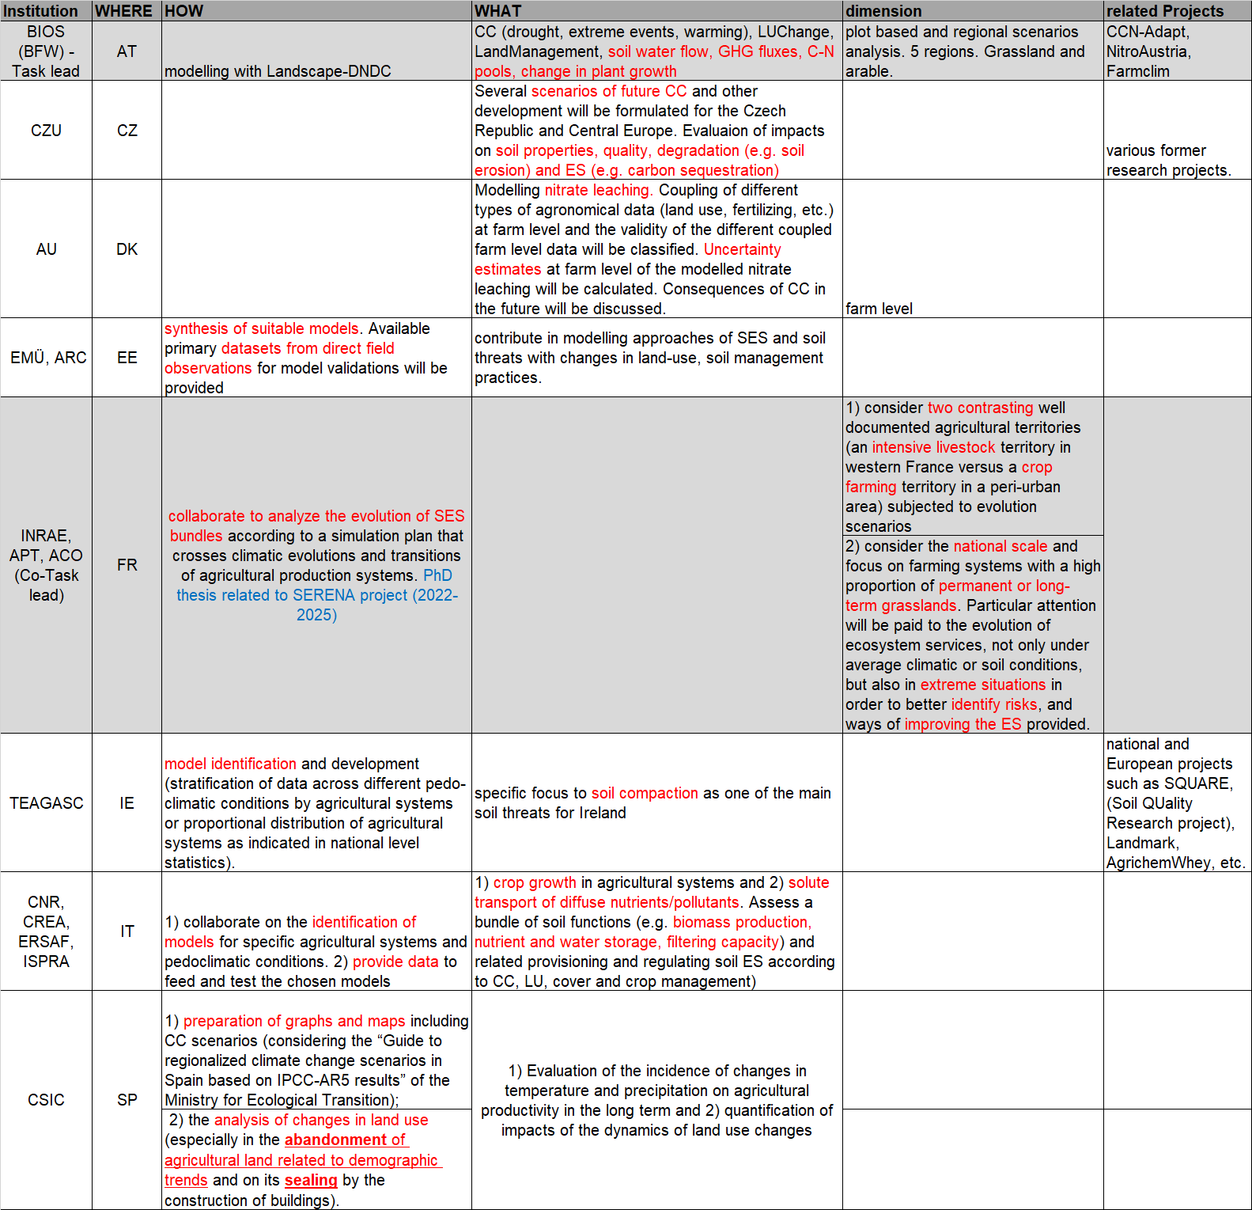
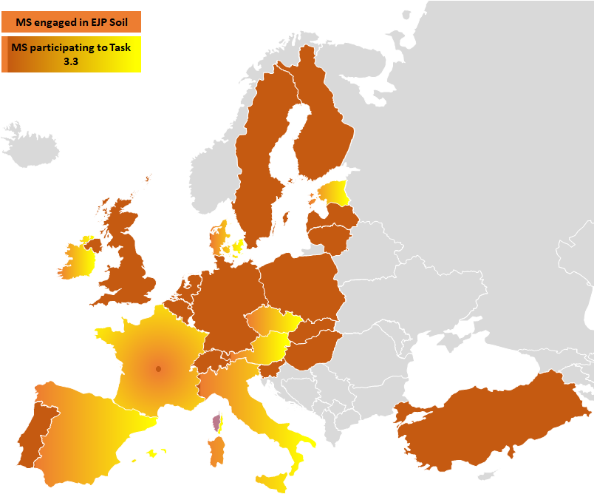
8 MS involved in the proposal

Slide 5
Deliverables and Milestones T3.3
Number | Month | Title | Description | done
M3.4 | Feb. 23 | Review of existing modeling studies focusing on SES and ST incl. CC, LU, LM scenarios | Extensive literature review on studies at local/regional or national scale | yes
M3.6 | Mai. 23 | Selection on SES/ST/bundles to study; models chosen | Which threats, SES, ST, bundles in which MS, which models? | In progress
M3.7 | Sep. 23 | Development of a scenario framework integrating recommendations provided by stakeholders (WP1 and WP2) | Scenario framework
M3.8 | Nov. 23 | List of forecasts to be done | Which threats, ES, bundles in which MS? Which modelling approach?
D3.4 | Sep. 24 | Evaluation of ST/ES und CC/LM and LU scenarios | Scenario analysis delivered

Slide 6
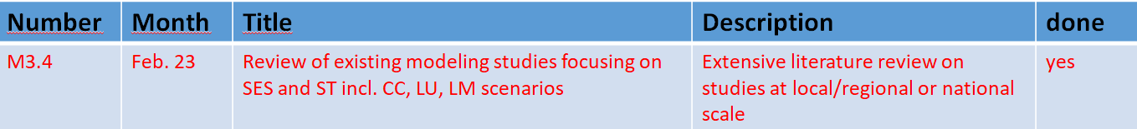
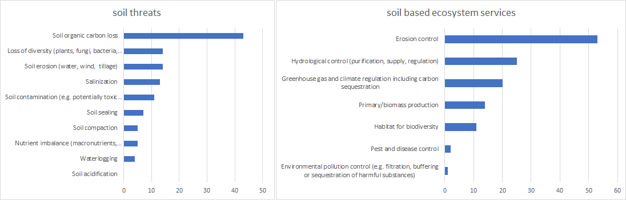
    M3.4 Extensive literature review on modelling studies including CC, LU and management scenarios
Global search, WOS and SCOPUS (~1000 papers, 200 used, 20 persons involved)
up to 90 parameters per paper extracted (general info, ES-ST assessment, scenarios, mapping, relationships, main findings)
Review completed, harmonization in progress

Slide 7
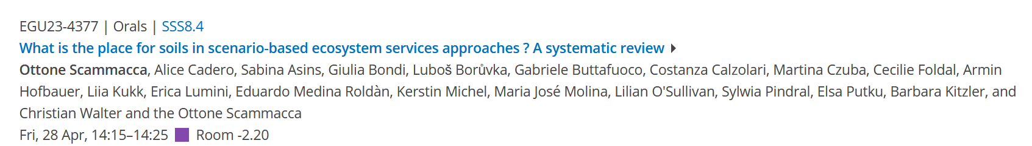
M3.4. What will be done in the coming months?
Harmonization of tables included in the literature review
Proceed with evaluation of literature review
Prepare a presentation at EGU 2023 in Vienna
Prepare a publication - meta analysis
Use gathered information for D3.4 - Evaluation of ST/ES und CC/LM and LU scenarios

Slide 8
M3.6. What will be done in the coming months?
2. Decisions on scenarios in a newly established « Scenarios Working Group »
    So far we decided (more or less) to use the same CC scenarios used in WP5 which simulates SES and ST on EU level. Time frame (until 2050?)
    So far, we decided (more or less) to use the output from LUISA (land-use change until 2050)
    So far, we did not decide on management scenarios! Depends on T1.4 and stakeholders!!
    So far, MS filled a table on possible contribution to M3.6 – M3.8 and D3.4.
To be discussed:
Who else is able to participate in M 3.6?
How to use the scenarios summarized in T1.4 for work in T3.3?

Slide 9
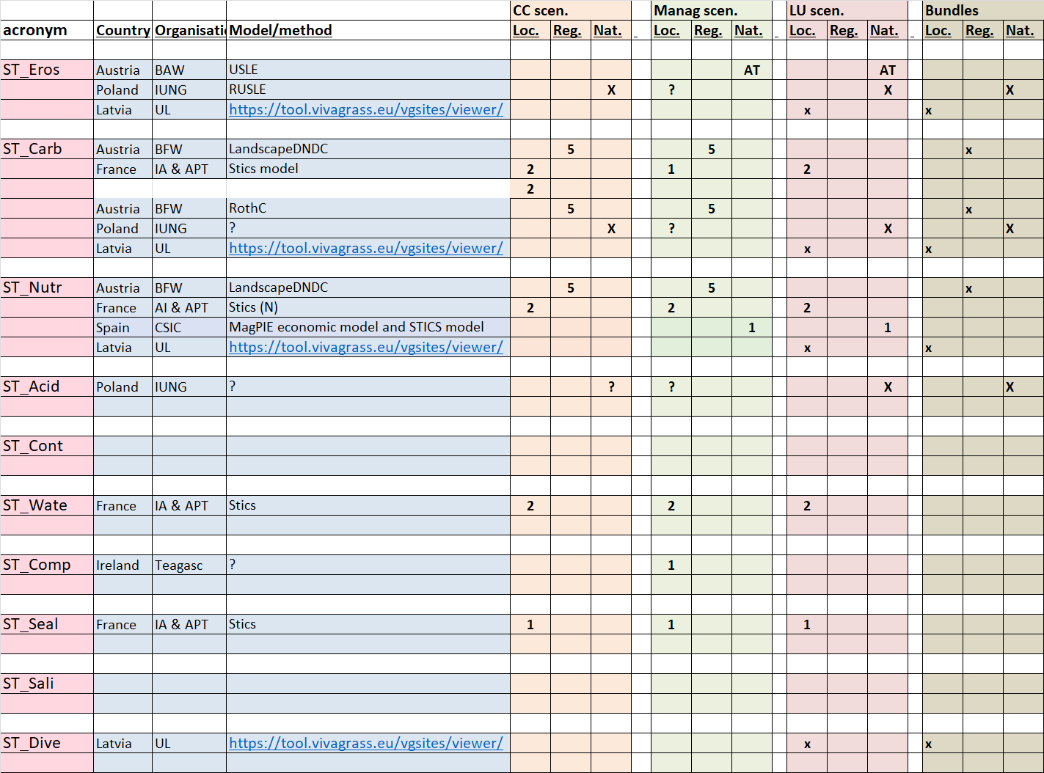
Possible ST modelled within T3.3
6 countries contribute
(AT, PL, LT, FR, SP, IR)
3 ST with > 3 countries
5 ST with 1 country
- 2 STs can not be simulated right now
Any further partners here in the audience???

Slide 10
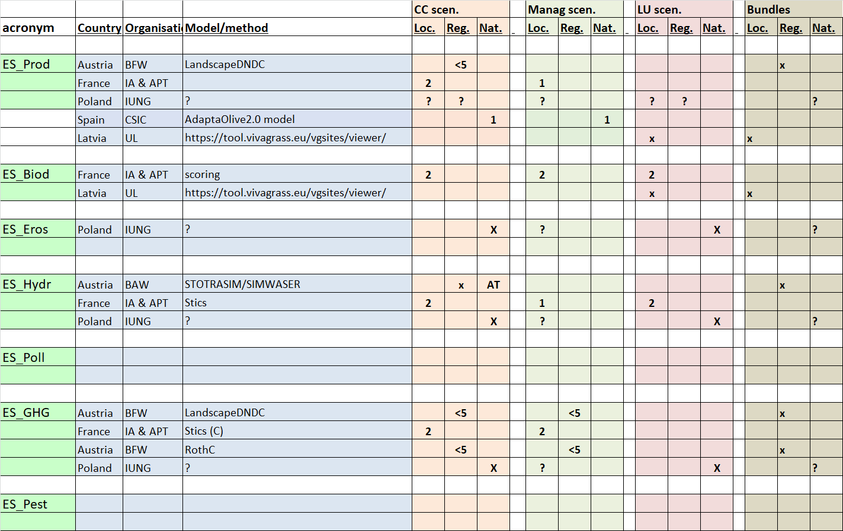
Possible SES modelled within T3.3
5 countries contribute
(AT, PL, LT, FR, SP)
2 SES with < 2 countries
- 2 SES can not be simulated right now
Any further partners here in the audience???

Slide 11
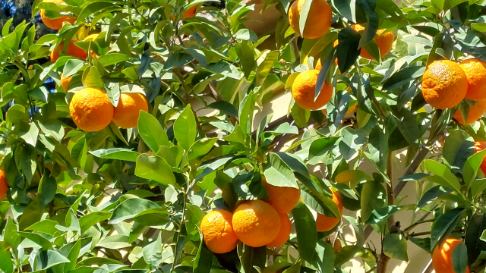
Thank you for your attention!
Grazie per l'attenzione!
Danke für Ihre Aufmerksamkeit!
Merci de votre attention!

